Slide 1

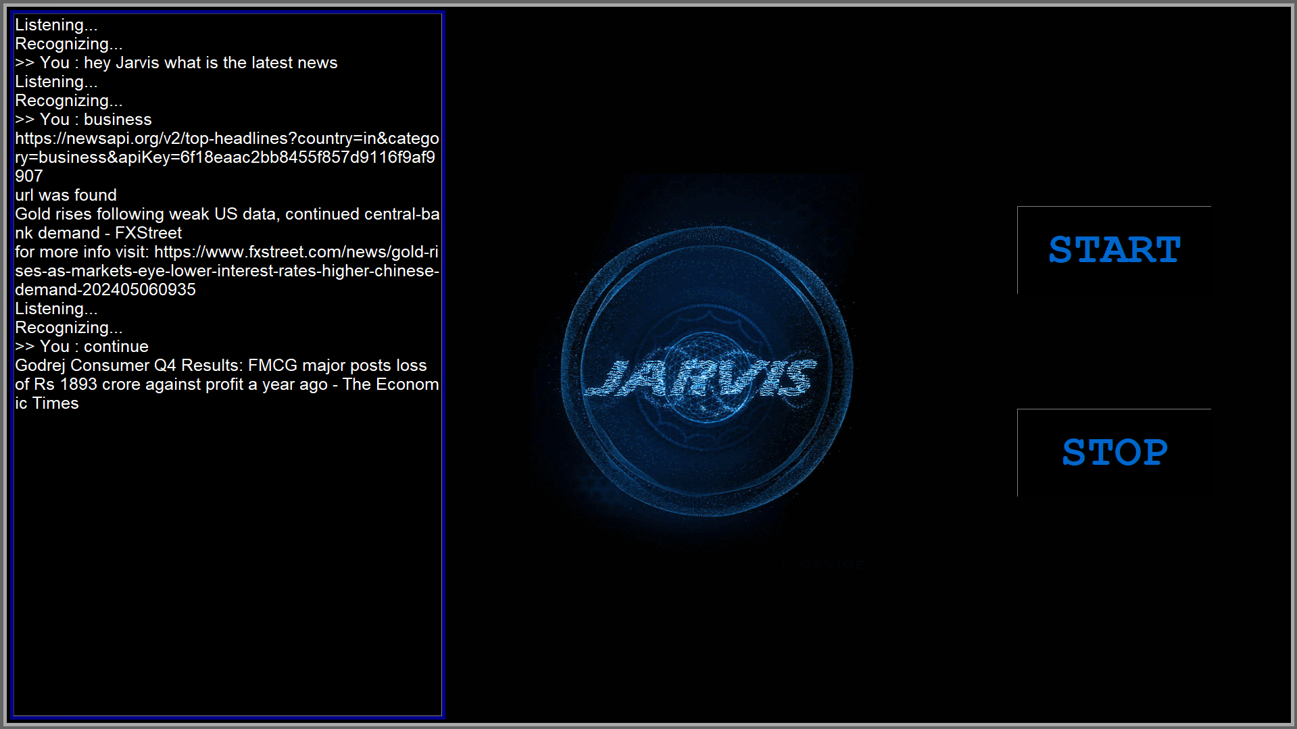
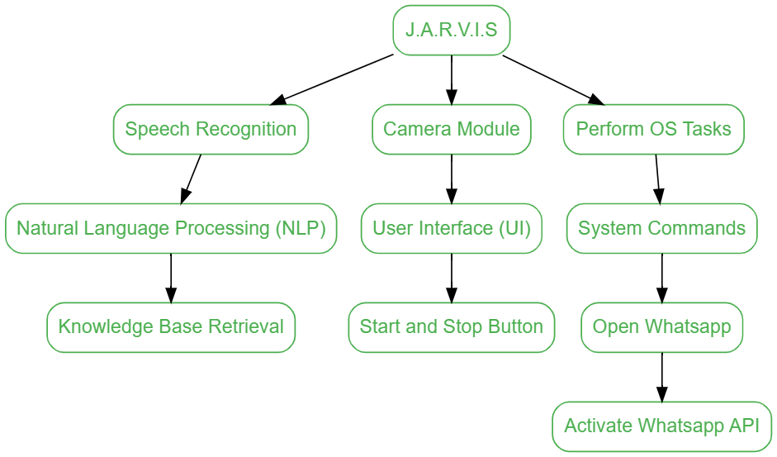
Sardar Patel Institute of Technology
Department of Computer Engineering
Academic Year 2023-24
Title: JARVIS – THE VIRTUAL ASSISTANT
Names: MAYUR SOLANKAR, MANISH JADHAV, VISHESH SAVANI - B.Tech.(Comp.)
Project Guide : DR. PRASENJIT BHAVATHANKAR
Abstract
The JARVIS project aimed to create a virtual assistant with enhanced language processing capabilities English, integrating OS-related features and a camera module. By implementing voice recognition, command execution, and API integration, along with a dictionary for word identification, the project successfully enhanced user-device interaction. Key findings include improved voice recognition accuracy and streamlined command execution, culminating in a versatile virtual assistant for various tasks.
Methodology/Algorithms
1. Initialize: Initialize the virtual assistant system.
2. Voice Input Processing:
- Utilize Natural Language Processing (NLP) for voice recognition.
- Process voice commands for execution.
3. Integration with Operating System:
- Integrate with the OS for seamless interaction.
- Enable the assistant to perform system-level tasks.
4. API Integration and Assumption:
- Incorporate APIs for fetching information from external sources.
- Assume reliable internet connectivity and sufficient processing power.
Results
The project highlights a versatile virtual assistant with voice recognition, system interaction, API integration, and more.
Conclusion
The JARVIS project created a versatile virtual assistant with advanced language processing, OS integration, and a camera module. It shows that building an efficient assistant for diverse commands is possible. Future improvements could focus on usability, more features, and better performance, making it a valuable tool for various tasks.
References
1. Smith, J., & Johnson, R. (2022). "Advancements in Virtual Assistant Technology."
2. Brown, A., & Williams, C. (2021). "Integrating APIs for Enhanced Virtual Assistant Functionality."
Introduction
The JARVIS project meets the demand for a versatile virtual assistant by incorporating advanced language processing capabilities and seamless integration with the operating system. This integration is designed to streamline user-device interaction, making it more intuitive and efficient. The project's ultimate goal is to enhance the overall user experience by providing a comprehensive and user-friendly virtual assistant solution.
Objectives
- Develop robust language processing for accurate voice recognition.
- Integrate OS features for seamless system interaction.
- Implement a camera module for enhanced visual input.
- Focus on improving user experience and task efficiency.
Problem Definition
The project aims to enhance language processing, OS integration, and functionality by adding a camera module. It seeks to create a versatile assistant capable of efficiently executing user commands across various tasks, addressing existing limitations in virtual assistants.
Contribution
Integrated API for real-time information updates.
Added WhatsApp feature for messaging broadening the virtual assistant's functionality to include communication tasks, thus enhancing its utility and user engagement.
Added OS features for performing system tasks.
Design

